Slide 1
JAVA Programming
Course Instructor: Dr. Syed Sajid Hussain
School of Computer Science
UPES Dehradun

Slide 2
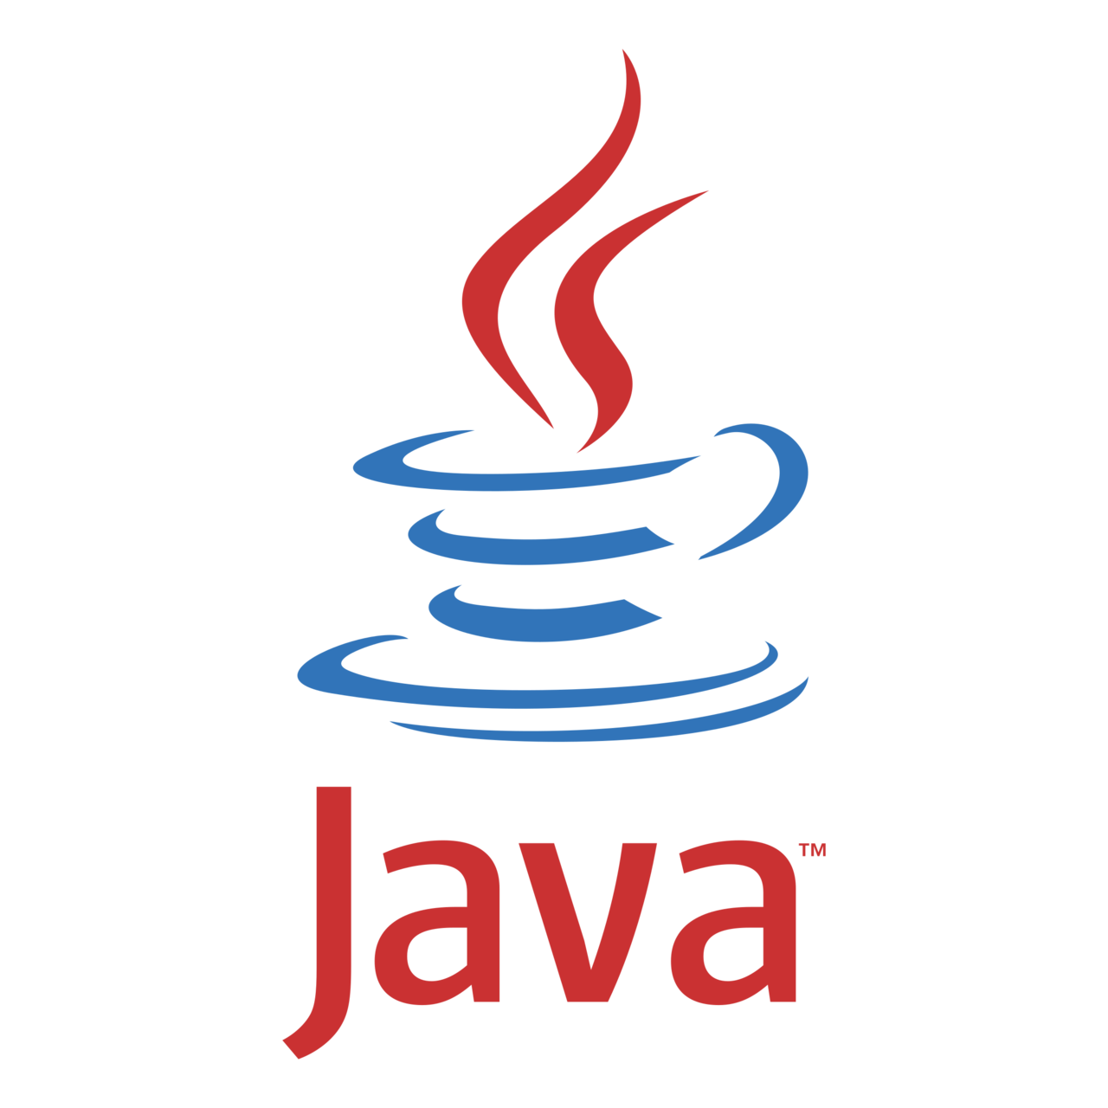
Let’s START THE JOURNEY Together…!!!

Slide 3
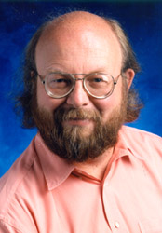
Brief History of JAVA
James Gosling, Mike Sheridan, and Patrick Naughton initiated the Java language project in June 1991. This small team of Sun engineers was called Green Team.
Firstly, the language was called “Greentalk” by James Gosling, and file extension was .gt.
Java was originally designed for small, embedded systems in electronic appliances like set-top boxes, but at that time, it was too advanced technology for the digital cable television industry.
After that, it was called Oak, and was developed as a part of the Green project. Java team-members initiated this project to develop a language for digital devices.
Later, Java technology was incorporated by Netscape as it was suited for networking.
James Gosling

Slide 4

Why the name JAVA???
Java was called Oak as it is a symbol of strength and chosen as a national tree of many countries like U.S.A., France, Germany, Romania, etc.
The team wanted something that reflected the essence of the technology: revolutionary, dynamic, lively, cool, unique, and easy to spell and fun to say.
In 1995, Oak was renamed as Java (An island of Indonesia is named Java where first coffee was produced, called java coffee)
In 1995, Time Magazine called Java one of ten best products of 1995.
JDK (Java Development Kit) 1.0 released in January23, 1996.

Slide 5
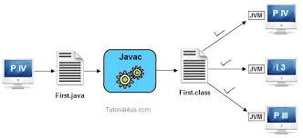
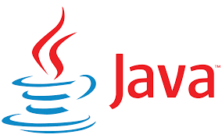
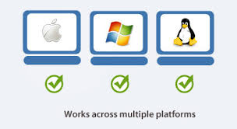


Characteristics of JAVA
Robust
Simple
Architecture-Neutral
Object
Oriented
Platform Independent / Portable
Distributed
Dynamic
Secure
High
Performance
Multi-threaded

Slide 6
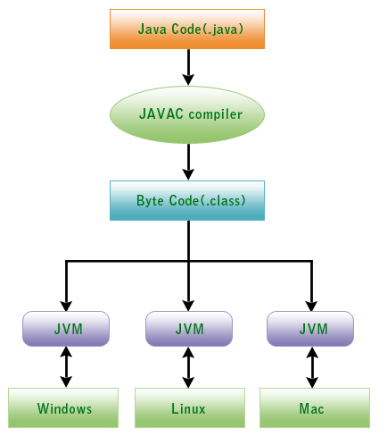
JAVA is Architecture-Neutral
Write (W)
Once (O)
Run (R)
Anywhere (A)

Slide 7
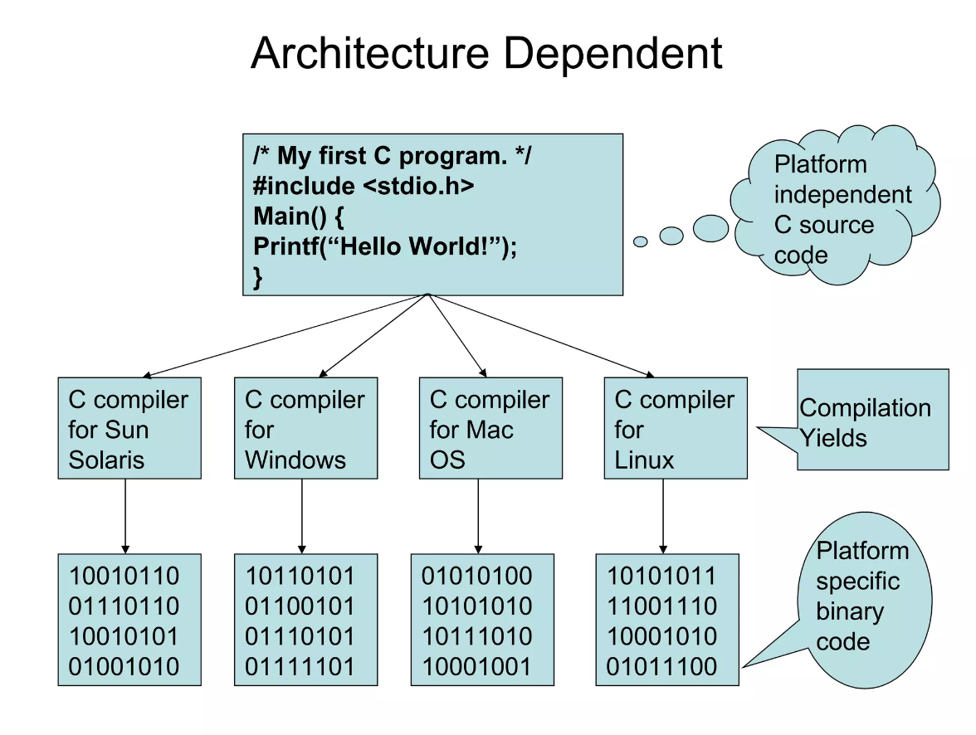
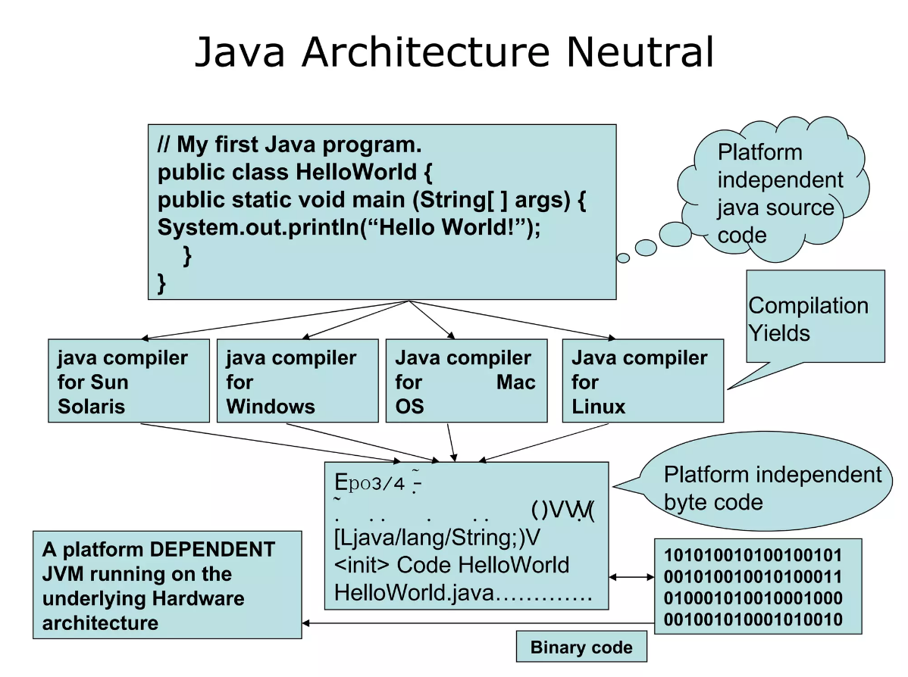
JAVA is Architecture-Neutral (Contd..)

Slide 8
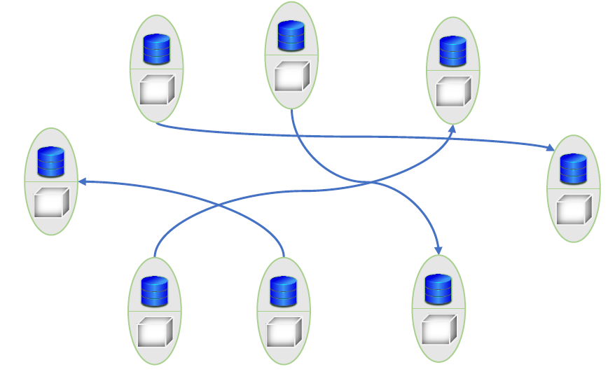
Object Oriented Paradigm of JAVA
Java is based on the concept of Object-Oriented Programming (OOP).
As the name suggests, at the centre of it is (are) an object(s).
Objects contain both data and the functionality that operates on that data.
Encapsulation
Inheritance
Information hiding
Polymorphism

Slide 9
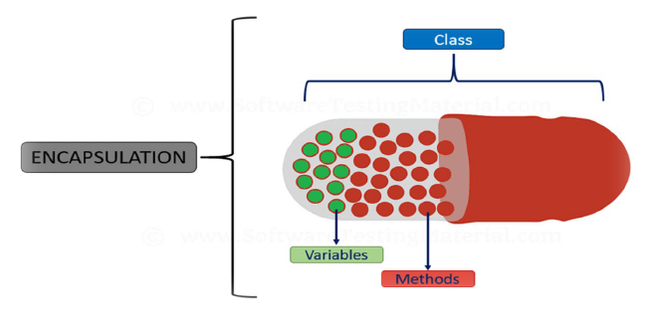
Encapsulation
Encapsulation in Java is a process of wrapping code and data together into a single unit.
For example, a capsule which is a mix of several medicines.

Slide 10
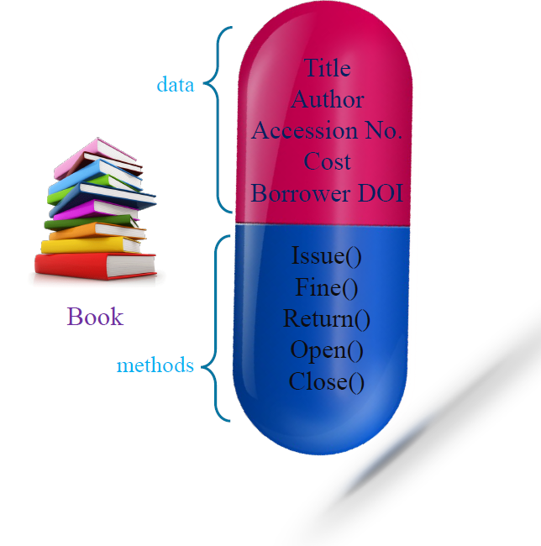
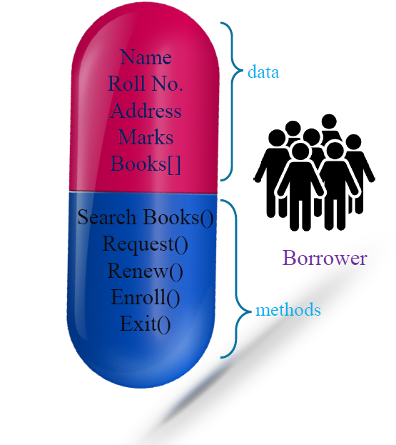
Encapsulation (Example)

Slide 11
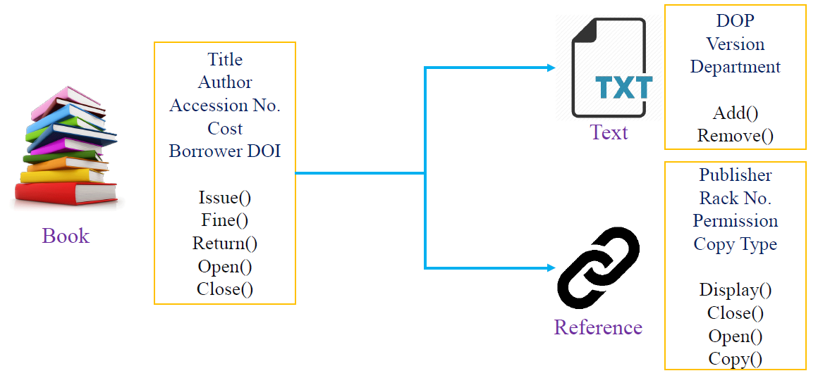
Inheritance
Inheritance in Java is a mechanism in which one object acquires all the properties (data) and behaviours (methods) of a parent object.
The Child object may have its own data and methods as well.

Slide 12
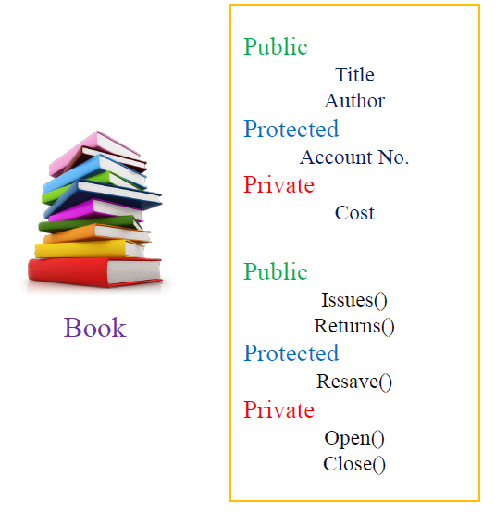
Information hiding
In Java, we have access specifiers which allow the one class of objects to hide relevant information from its child objects and objects of other classes.
Public
Protected
Private

Slide 13
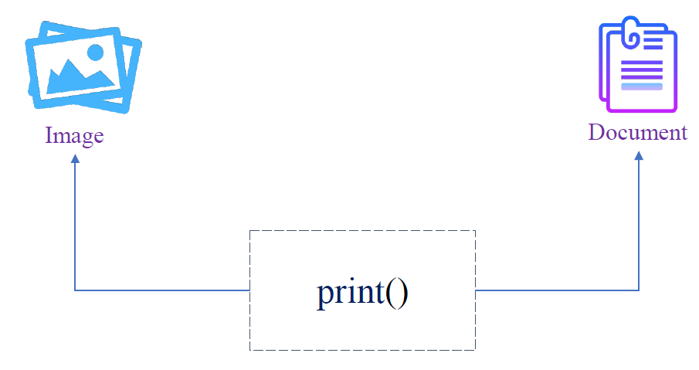
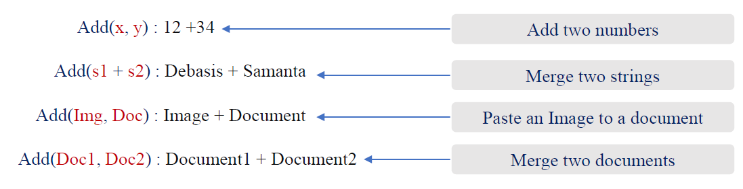
Polymorphism
In Object Oriented Programming (OOP),
Polymorphism refers to a programming language’s ability to process objects depending on their class.

Slide 14
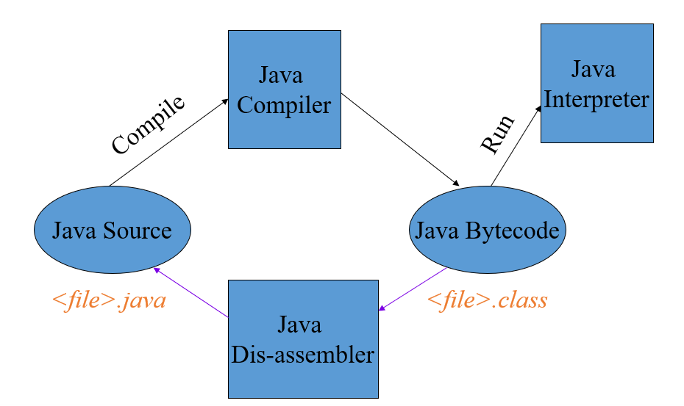
JAVA Program Back-end Setup
Java Developer’s Kit (JDK) – I
Java’s programming environment
  Core Java API
  compiler
  interpreter
  debugger
  dis-assembler
  profiler
  more...

Slide 15
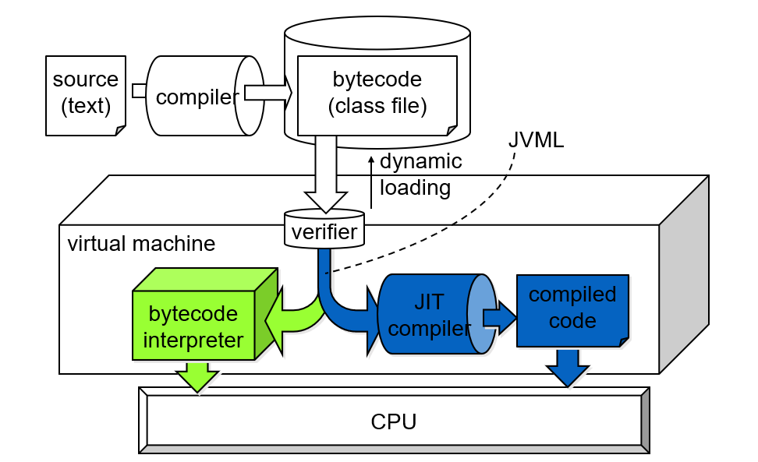
Execution of JAVA Program

Slide 16
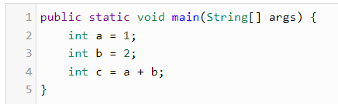
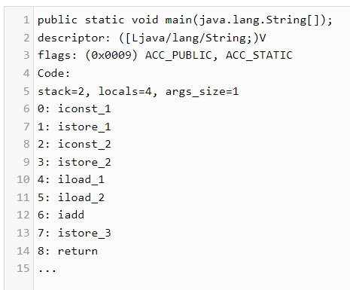
Bytecode
For most languages, compilation produces machine code
Java compilation produces “bytecode”
    Intermediate code readable by the VM
    Transferable across the Internet as applets
JVM interprets bytecodes into instructions
    Partly responsible for performance lag
  Bytecode produced on any platform may be executed on any other platform which supports a VM

Slide 17
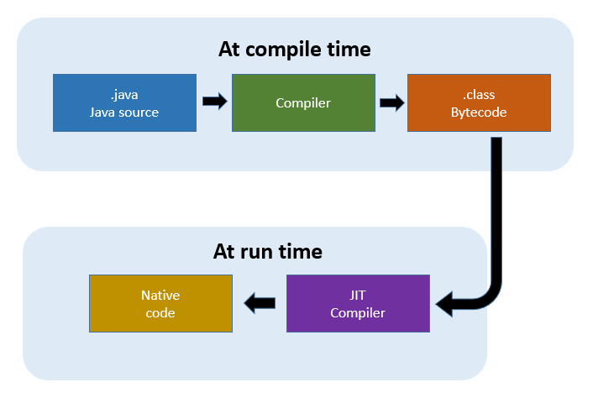
JIT Compiler
Just-In-Time compiler
Translates bytecode into machine code at runtime
    1-time overhead when run initiated
    Performance increase 10-30 times
Now the default for most JVM’s
    Can be turned off if desired
    JIT can apply statistical optimizations based on runtime usage profile

Slide 18
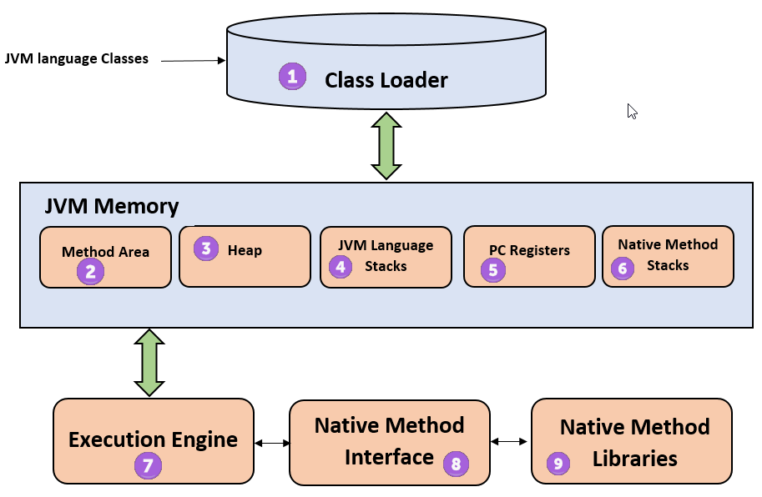
Java Virtual Machine (JVM)
Not just one JVM, but a whole family
JVM (J2EE & J2SE)
    Well-known Java Virtual Machine.
CVM, KVM (J2ME)
    Small devices.
    Reduces some VM features to fit resource-constrained devices.
JCVM (Java Card)
    Smart cards.
    It has least VM features, etc.

Slide 19
Summary
Today, we learned about
Brief History of JAVA Programming
Features of JAVA Programming Language
Why JAVA is Architecture-Neutral / Portable / Platform-independent?
OOP Concepts in JAVA
      Encapsulation
      Inheritance
      Information hiding
      Polymorphism
Back-end Setup and Execution model for JAVA program
      Bytecode
      JIT Compiler
      JVM

Slide 20


